Slide 1
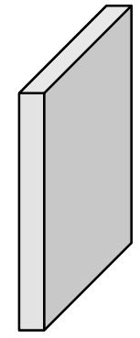
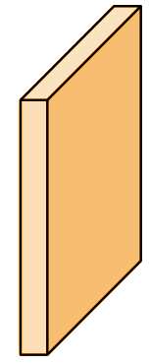
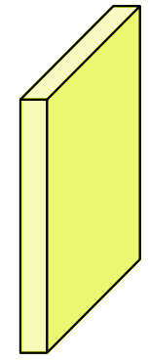
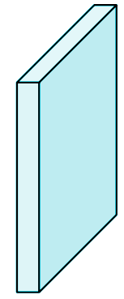
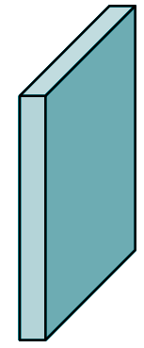
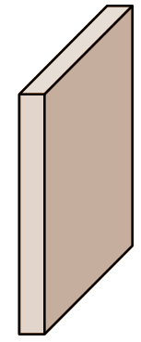
Conv2D
3x3, 4*(4+C)
38 x 38 x 4 x (4+C)
Conv2D
3x3, 6*(4+C)
19 x 19 x 6 x (4+C)
Conv2D
3x3, 6*(4+C)
10 x 10 x 6 x (4+C)
Conv2D
3x3, 6*(4+C)
5 x 5 x 6 x (4+C)
Earlier VGG Layers
Conv2D
3x3, 6*(4+C)
3 x 3 x 4 x (4+C)
Conv2D
3x3, 6*(4+C)
1 x 1 x 4 x (4+C)
38 x 38 x 256
Block 4
19 x 19 x 512
Block 5
19 x 19 x 1024
SSD 1
10 x 10 x 512
SSD 2
5 x 5 x 256
SSD 3
3 x 3 x 256
SSD 4
1 x 1 x 256
SSD 5
SSD Architecture

Slide 2
Grid Size | # Priors per cell | # of RoIs | # of Outputs (for C Classes)
38 x 38 | 4 | 5,776 | 38 x 38 x 4 x (4+C)
19 x 19 | 6 | 2,166 | 19 x 19 x 6 x (4+C)
10 x 10 | 6 | 600 | 10 x 10 x 6 x (4+C)
5 x 5 | 6 | 150 | 5 x 5 x 6 x (4+C)
3 x 3 | 4 | 36 | 3 x 3 x 4 x (4+C)
1 x 1 | 4 | 4 | 1 x 1 x 4 x (4+C)
Total |  | 8,732
For each box, we need the following outputs:
- Classification : Number of classes + 1 (for background)
- Regression : 4 (x, y, w, h)
Grid size and # priors used in original SSD paper

Slide 3
SSD
YOLO v3
Feature Network
ResNet / Inception / MobileNet
DarkNet
Number of Grids
6
3
Grid Sizes
38, 19, 10, 5, 3, 1
13, 26, 52
Number of RoIs per Grid
4 to 6
3
Number of outputs per RoI
4 + C
5 + C
(Extra output is Object score)

Slide 4
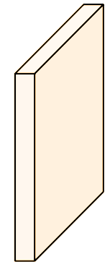
Output for 26x26 Grid
52 x 52 x 3 x (5+C)
Output for 13x13 Grid
26 x26 x 3 x (5+C)
13 x 13 x 3 x (5+C)
Conv2D
3x3, 3*(5+C)
Conv2D
3x3, 3*(5+C)
Conv2D
3x3, 3*(5+C)
DarkNet
Layers
13 x 13 x D1
Layer 79
26x26 x D2
Upsample
26x26 x D2
Layer 91
52x52x D3
Upsample
5 2 52 x D3
Layer 102
YOLO v3 Architecture

Slide 5
YOLO Summary
Grid Size | # RoIs per cell | Total RoIs | # of Outputs (for C Classes)
13 x 13 | 3 | 507 | 13 x 13 x 3 x (5+C)
26 x 26 | 3 | 2,028 | 26 x 26 x 3 x (5+C)
52 x 52 | 3 | 8,112 | 52 x 52 x 3 x (5+C)
Total |  | 10,647

